Slide 1
Programming for Business
Exploratory Data Analysis (EDA) FAST–NUCES
Miss Shumaila Arshad

Slide 2
What is EDA?
EDA stands for: Exploratory Data Analysis
EDA (Exploratory Data Analysis) is the process of analysing and summarizing data to understand its structure, patterns, and relationships before applying any model.
Goal: To understand data BEFORE modeling.

Slide 3
Why EDA is important?
• Detect missing values
• Identify outliers
• Understand distribution
• Improve ML models
Reason: Garbage in = Garbage out

Slide 4
Missing Values Example
Age | Salary
25 | 50000
30 | NaN
NaN -> Not a Number
Problem: Models cannot handle missing data. Solution: Fix it using mean, median, or remove a row with missing data.

Slide 5
Outliers Example
10, 12, 11, 500
500 is outlier
Outliers disturb average and predictions.
Notes:
Ask students which value is different.
Explain 500 is outlier.
Outliers disturb average and predictions.

Slide 6
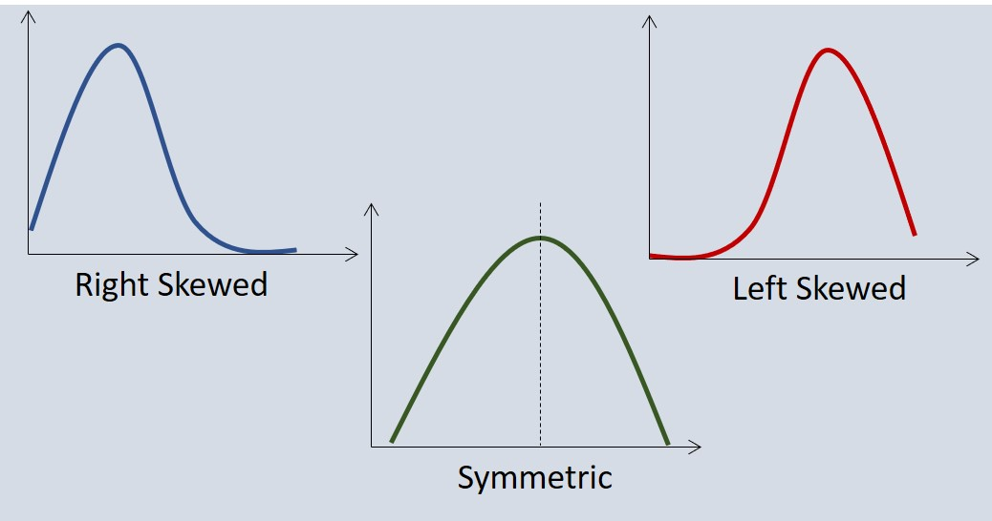
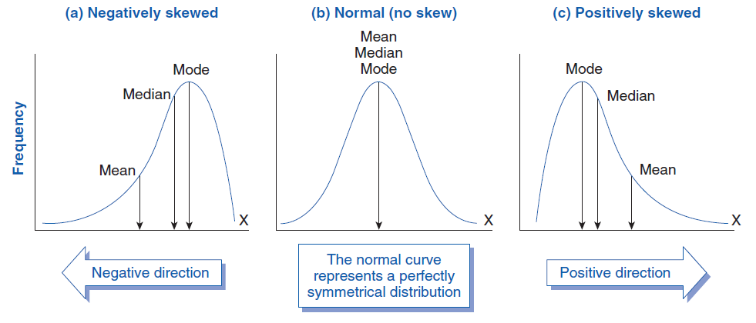
Distribution
Normal vs Skewed Data

Slide 7
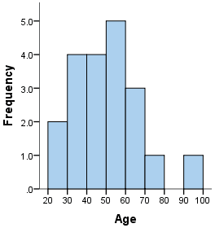
Histogram
A histogram shows:
“How many values fall in different ranges”
It shows Distribution of data ✔ Frequency of values

Slide 8
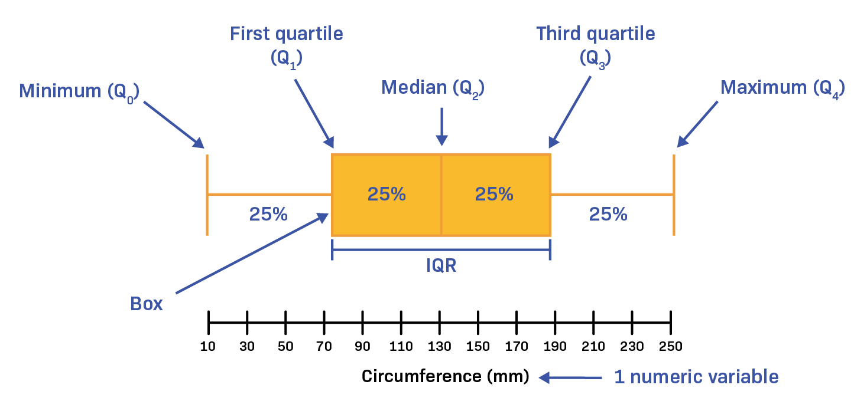
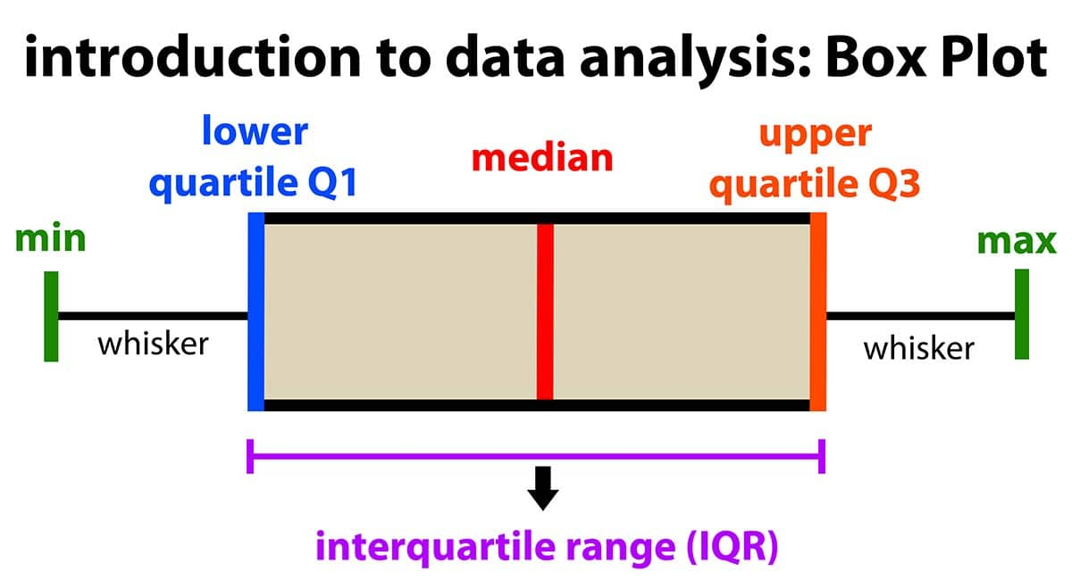
Boxplot
Notes:
Explain boxplot visually detects outliers.

Slide 9
Box plot
What does boxplot show?
✔ Spread of data ✔ Median ✔ Outliers
Real-Life Example
Marks of students:
10, 12, 14, 16, 18, 20, 22, 30
Boxplot shows where most data lies and helps detect unusual values.

Slide 10
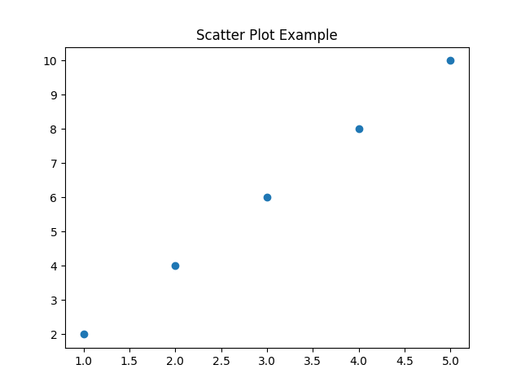
Scatter Plot
• A scatter plot shows:
“Relationship between two things”
“Scatter plot shows how two variables are related”
Notes:
Explain relationship between variables.

Slide 11
Scatter Plot
👉 Each row becomes a point
Example:
(1,2), (2,4), (3,6), (4,8), (5,10)
👉 These are plotted as dots
Study Hours | Marks
1 | 2
2 | 4
3 | 6
4 | 8
5 | 10

Slide 12
Types of Relationships
✅ Positive Relationship
👉 As X increases → Y increases
Example:
Study ↑ → Marks ↑
❌ Negative Relationship
👉 As X increases → Y decreases
Example:
Screen time ↑ → Grades ↓
⚖️ No Relationship
👉 Points scattered randomly
Example:
Shoe size vs marks

Slide 13
Correlation
👉 Correlation means:
“How two things are related”
Real Life Example
👉 As study increases → marks increase
✔ This is correlation
Notes:
Explain correlation meaning.

Slide 14
Correlation
👉 Correlation is always between:
-1 to 1
Value | Meaning
+1 | Perfect positive
0 | No relation
-1 | Perfect negative

Slide 15
Positive Correlation (+1)
👉 Both increase together
Example:
Study ↑ → Marks ↑
Exercise ↑ → Health ↑
✔ Graph goes upward

Slide 16
Negative Correlation (-1)
👉 One increases, other decreases
Example:
Screen time ↑ → Marks ↓
Price ↑ → Sales ↓
✔ Graph goes downward

Slide 17
No Correlation (0)
👉 No relationship
Example:
Shoe size vs marks
✔ Points scattered randomly

Slide 18
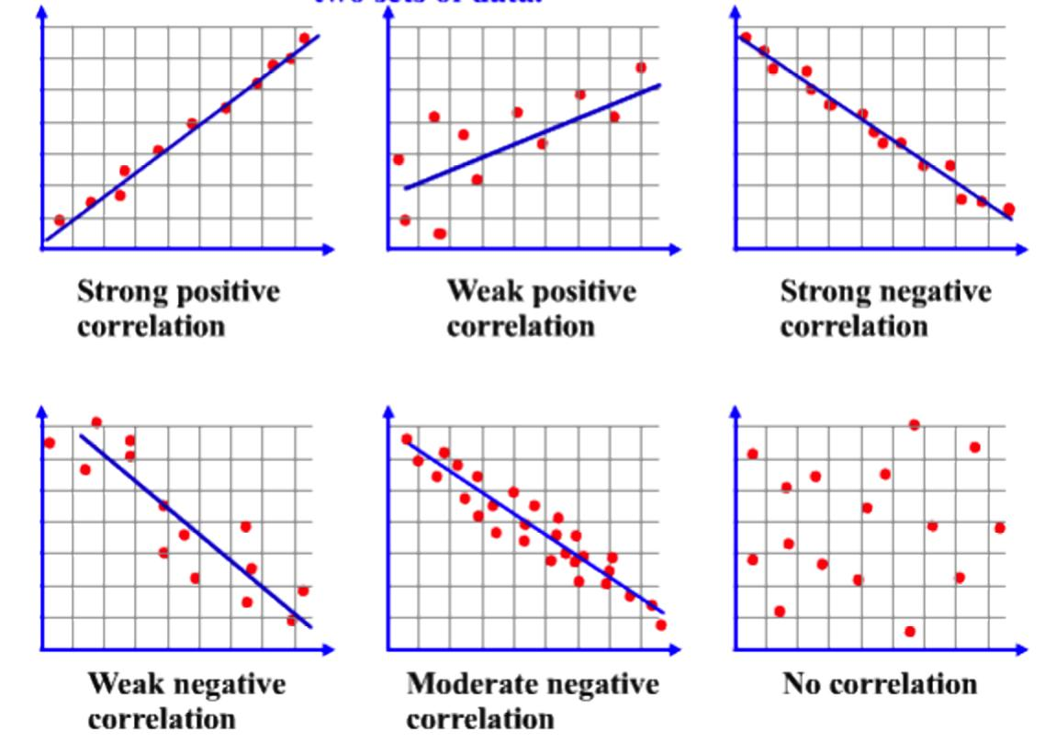
Visual Understanding

Slide 19
Garbage in Garbage out
Bad data → Bad results
If you give bad data so you will get bad results.
Notes:
Explain importance of clean data.

Slide 20
Real Life Example of EDA
E-commerce: Analyze customer purchases
Bank: Detect fraud
Healthcare: Analyze patient data

Slide 21
Missing Values Problem
Salary missing → affects model
Solution: Mean/Median/Mode

Slide 22
Common Mistakes
Skipping EDA
Ignoring outliers
Wrong assumptions

Slide 23
Tools based on EDA
Python, Pandas, NumPy, Seaborn, Excel

Slide 24
Import matplotlib (Explanation)
👉 matplotlib.pyplot is a module (part of a library) used to create graphs in Python.
📦 matplotlib
A Python library for data visualization
Used to create charts, graphs, plots
🎯 pyplot
A sub-module inside matplotlib
Provides simple functions to:
plot graphs
show charts
label axes

Slide 25
Syntax
Using pyplot, you can create:
Line graphs → plt.plot()
Bar charts → plt.bar()
Histograms → plt.hist()
Scatter plots → plt.scatter()

Slide 26
Code Implementation Example 1
import numpy as np
import matplotlib.pyplot as plt
#plt is a shortcut name or alias
# Create left skew manually
data = np.random.exponential(scale=2, size=1000)
data = -data # flip
plt.hist(data)
plt.title("Left Skewed Distribution")
plt.show()

Slide 27
Example 2
import matplotlib.pyplot as plt
Hours = [1, 2, 3, 4]
Marks = [20, 40, 60, 80]
plt.scatter(Hours, Marks)
plt.show()

Slide 28
Conclusion
EDA improves data quality and model accuracy
EDA cleans data, removes errors, helps better decisions.

